Slide 1

F L OOD D E T E CT I O N A N D
I N T I M AT I O N
SUBMITTED BY : ISHAAN REJRA 20BCE2847 SOMYA RATHI 20BCE2323
ARYAN AGRAWAL 20BCE2876

Slide 2
AIM AND OBJECTIVE :
“Flood Detection And Intimation” is an intelligent system which keeps close watch over various natural factors to predict a flood, so we can embrace ourselves for caution, to minimize the damage caused by the flood.
To detect a flood the system observes various natural factors, which includes humidity, temperature, water level and flow level.To collect data of mentioned natural factors the system consist of different sensors which collects data for individual parameters. For detecting changes in humidity and temperature the system has a DHT11 Digital Temperature Humidity Sensor. It is a advanced sensor module with consists of resistive humidity and temperature detection components.The system also consist of a HC-SR04 Ultrasonic Range Finder Distance Sensor.The Ultrasonic sensor works on the principle of SONAR and is designed to measure the distance using ultrasonic wave to determine the distance of an object from the sensor. All the sensors are connected to Arduino UNO, which processes and saves data.

Slide 3
PROPOSED SYSTEM:
This project intend to provide a correlation between water level(distance), humidity, temperature, with the help of sensors like DHT 11, HC SR-04, LED, ALARM (sound alert), and intimates about the flood
Also, it consists of Buzzer system which is effective from a threshold of under 10cm and beeps
when the object is at a distance less than 10cm
If the ultrasonic sensor detect a movement within its range, then alarm is activated notifying danger ,that helps in early prediction of flood. And gives appropriate time to deal the situation in best possible manner

Slide 4
Literature Survey
Title | Author & year | Purpose | Methods/ technology used | Limitations/ gaps identified
Flood detector using Arduino | Roy Allan Santos, Ryan Richard Guadaña, Our Lady of Fatima University.2016 | Flood is an unavoidable natural disaster in Metro Manila, Philippines, causing heavy flow of traffic and can also cause severe damage to properties and lives.For this reason, researchers created a flood detection system to monitor rising water in residential areas. | Ultrasonic Sensor,Arduino Yun, Flood sensor and microcontroller, solar power bank with 80,000 Ampere-Hour (mAh),LED,Camera | In the proposed system when the level of water goes below a certain limit, the HC-SR04 starts showing some ir-regular values of distance.

Slide 5
Survey on Flooding Detection System using Internet of Things | Mahendra Salunke, Nilesh Korade May 2017 | This paper aims to realize the security requirement and security architecture of Internet of things technology for urban flooding prevention management system and discussed the demand and overall design of urban flooding prevention management system. | Ultrasonic Flow-meter,Water Level Indicator,Rain sensor | In places like J&K, there are longer tunnels that are under construction, Panjal Railway Tunnel it is part of the USBRL Project having length 11.2 km long. The system will not be able to effectively calculate how much time will required to fill tunnel so travelers get the information about flooding.

Slide 6
Flood detecting and alerting system | Tera.Shobhitha, Shaik.Abdul Shabbir,Vesapogu.Jyothi Priya , Sajja.Priyanka and Dr.Kalyanapu.Srinivas. 2022 | The floods occurs due to the release of water from the dams but also the overflow of water from the manholes can also cause flood which affects the people who are living in that particular area. So the system that we are proposing can be implemented to both detection of flood from the dams as well as the over flooding of water from sewers. | Sensors,Microcontroller Node MCU,Ultrasonic sensor, water level sensor, temperature and humidity sensor, flow level sensor. | We are using solar cells to provide cheaper source of power to the entire system,but the main drawback of the solar cells is that although solar energy can still be collected during cloudy and rainy days, the efficiency of the solar system drops and it uses a lot of space.

Slide 7
Flood Detection using Sensor Network and Notification via SMS and Public Network | Azizah suliman.2011 | This paper focused on the development of the system which will determine the current water level by means of sensors and by using wireless sensor network will then provide notification via GSM modem. | Water level sensor PIC16F877A Radio frequency Global system communication mobile(GSM) | The most challenge in the SMS channel when the local people don’t use mobile service. The language problem to the foreign people is also one of the major issue.

Slide 8
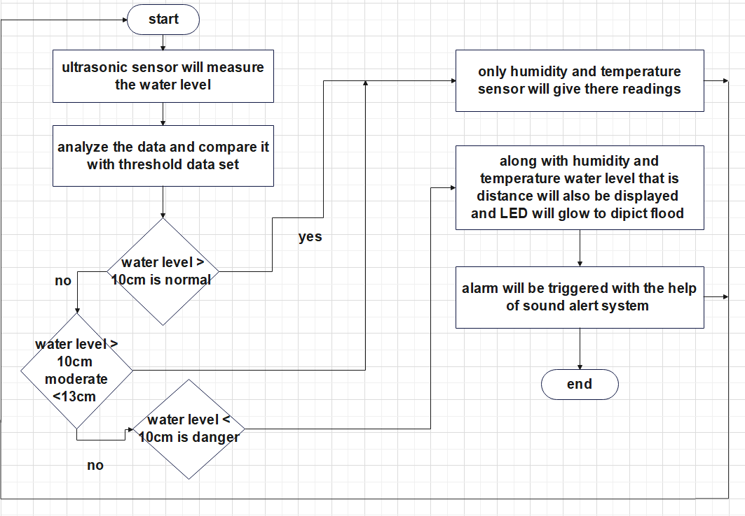
FLOW CHART:
This flow chart depicts the working of flow of the project

Slide 9
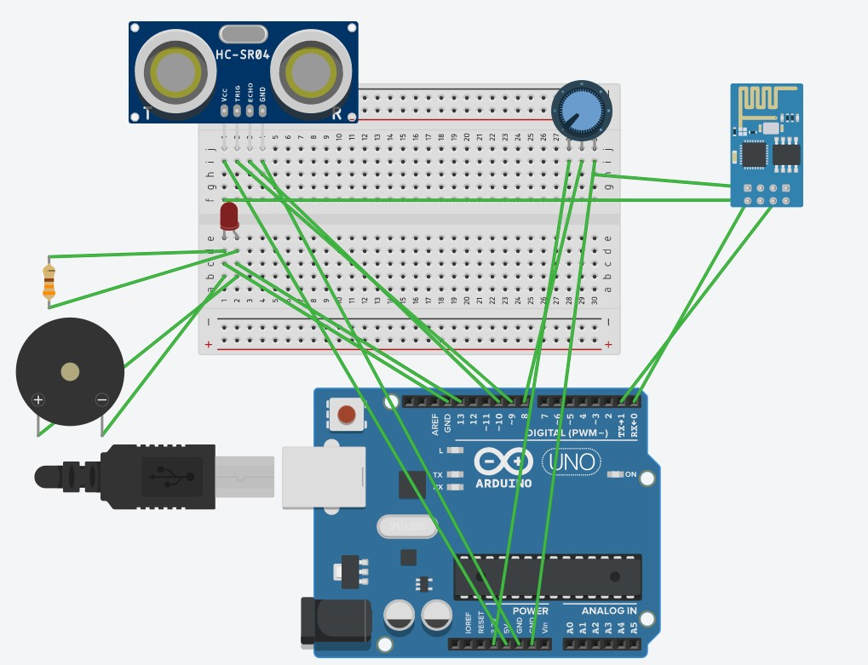
H A R DWA R E S E T U P A N D
M O D U L E S O F T H E P RO J E C T

Slide 10
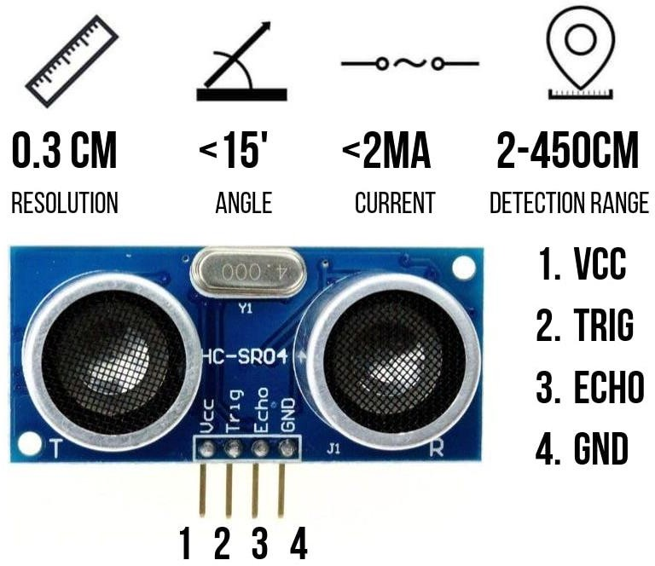
MODULE-1:WATER LEVEL DETECTION
This module concentrates on detecting the water level with the help of ultrasonic sensor (HC- SR04). It calculates distance using SONAR. Gives the information of the rise in water level above threshold.

Slide 11

MODULE-2: INDICATOR MODULE - LED
This module intimates the danger in the form of light signals (LED) whenever the reading goes over the threshold value.The LED turns high that indicates the danger.

Slide 12
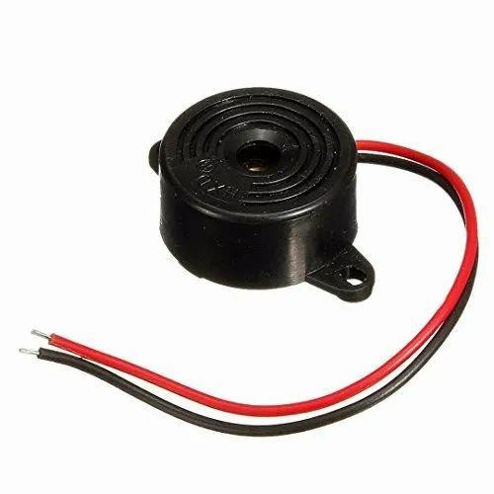
MODULE-3: SOUND ALERT- BUZZER
This module alerts the users in the form of sound.This happens whenever the reading goes above the specified threshold.
The buzzer beeps continuously whenever the object crosses the specified threshold.

Slide 13
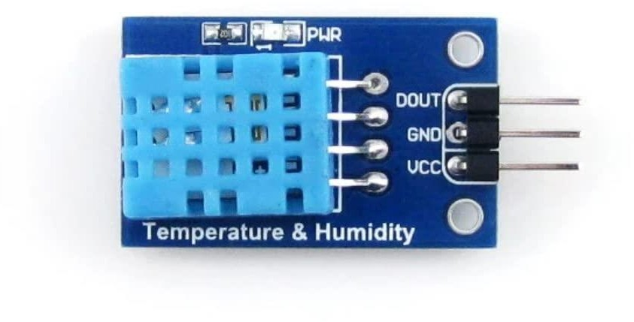
MODULE-4: TEMPERATURE AND HUMIDITY SENSOR
With the help of DHT11 sensor temperature and humidity readings are extracted
This module correlates environmental factors such as temperature and humidity to predict the flood more accurately

Slide 14
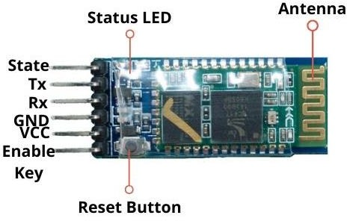
MODULE- 5:BLUETOOTH MODULE
Bluetooth module (HC-05) uses serial communication to communicate with other electronic devices such as cell phones on a base of wireless connection , so the date collected with the integration of all sensors is displayed in readable form on cell phone so that user understands the information and can act accordingly

Slide 15
CONCLUSION :
Proposed arrangement used for “Flood Detection And Intimation” has a lot of potential applications especially in flood prone areas and where the natural calamity like flood has caused huge losses in the past.This is an intelligent system that closely monitors many natural conditions to forecast a flood, allowing us to take precautions and limit the damage the flood does.
This system can be implemented on a large scale in near future as it’s a totally different concept and if it is made to implement properly with the help of the government- it can predict danger and save thousands, if not lakhs of lives by alerting of danger beforehand.

